Slide 1
Principles of the Software Design
Course for Armenian-French University
Areg Melik-Adamyan
Petr Kurapov

Slide 2
Lecture 6
First practice – A Build System

Slide 3
Agenda
Build tools – what, why, and how
Makefiles – problem, motivation, solution
Case study – designing a build tool from scratch

Slide 4
What is a Build Tools? – A Definition
A build tool is a program that automates the process of turning source code into a deployable program. Build tools can help improve productivity, consistency, and dependability by automating repetitive tasks.
Here are some things build tools can do:
Compile code: Convert source code into machine code that the computer can understand
Run tests: Run unit tests and report their results
Package code: Bundle compiled code into an executable form
Download dependencies: Download third-party dependencies
Preview changes: Automatically preview changes to an application
Combine files: E.g., combine JavaScript modules and CSS into bundled files
Minify files: Minify files to improve performance

Slide 5
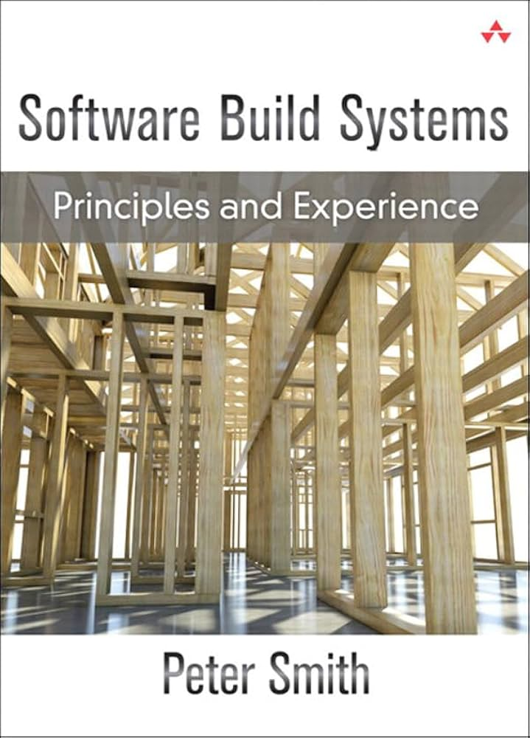
Excellent Source of Knowledge
Some examples and diagrams used from the book.
Software build systems; Principles and Experience. (2011). Reference and Research Book News, 26(3)

Slide 6
Why Build?
Anytime you want to do more than compile half a dozen files.
Simplifies software development and testing.
You want to make a change to your code and hit ‘go' which will compile all your code, run all your tests, and maybe even automatically generate documentation and deploy your application
And maybe do more.

Slide 7
What Can You Build?
Compilation of software from source to executable.
C, C++, Java, C#
Packaging.
Python, JavaScript/Node (Interpreted Languages)
Web based applications
Combination of compiling source, or hybrid source, along with configuration files.
Unit and integration testing.
Automatically generate documentation.
And more…

Slide 8
Make
Considered the first build tool. Bell Labs, 1976 by Stuart Feldman
Most commonly used for C/C++ development.
If you develop for legacy systems you will most likely have to deal with Make.
Not recommended for new projects, untrained and unstable minds.
Make originated with a visit from Steve Johnson (author of yacc, etc.), storming into my office, cursing the Fates that had caused him to waste a morning debugging a correct program (bug had been fixed, file hadn't been compiled, cc *.o was therefore unaffected). As I had spent a part of the previous evening coping with the same disaster on a project I was working on, the idea of a tool to solve it came up. It began with an elaborate idea of a dependency analyzer, boiled down to something much simpler, and turned into Make that weekend. Use of tools that were still wet was part of the culture. Makefiles were text files, not magically encoded binaries, because that was the Unix ethos: printable, debuggable, understandable stuff.
— Stuart Feldman, The Art of Unix Programming, Eric S. Raymond 2003

Slide 9
Make Files
Make is a program which automates building dependency trees
List of rules written in a Makefile declares the commands which build each intermediate part
Helps you avoid manually typing gcc commands, easier and less prone to typos
Automates build process
Makefiles are lists of Make rules which include:
Target - An output file to be generated, dependent on one or more sources
Source – Input source code to be built
Recipe - command to generate target
Makefile logic
Make builds based on structural organization of how code depends on other code as defined by includes
Recursive – if a source is also a target for other sources, must also evaluate its dependencies and remake as required
Make can check when you've last edited each file, and only build what is needed!
Files have "last modification date". make can check whether the sources are more recent than the target
Make isn’t language specific: recipe can be any valid shell command
run make command from within same folder
$make [ -f makefile] [ options ] … [ targets ] ../
Starts with first rule in file then follows dependency tree
-f specifies makefile name, if non provided will default to “Makefile”
if no target is specified will default to first listed in file
target: source
recipe
tab not spaces!
ll.o: ll.c ll.h
gcc -c ll.c
https://www.gnu.org/software/make/manual/make.html#Introduction

Slide 10
Makefile Example: Linked List
try_lists
#include "ll.h"
int main() {
Node *n1 = make_node(4, NULL);
// rest of main…
main.o
ll.o
main.c
#ifndef LL_H
#define LL_H
typedef struct Node {
// rest of Node def…
main.c
ll.h
ll.c
try_lists: ll.o main.o
gcc –o try_lists ll.o main.o
ll.o: ll.c ll.h
gcc –c ll.c –o ll.o
main.o: main.c ll.h
gcc –c main.c –o main.o
ll.h
#include <stdlib.h>
#include <stdio.h>
#include "ll.h"
Node *make_node(int value, Node *next) {
// rest of linked list code…
Makefile
ll.c

Slide 11
More Make Tools
CC = gcc
CGLAGS = -Wall
foo.o: foo.c foo.h bar.h
$(CC) $(CFLAGS) –c foo.c –o foo.o
make CFLAGS=-g
EXE=
ifdef WINDIR #defined on Windows
EXE=.exe
endif
widget$(EXE): foo.o bar.o
$(CC) $(CFLAGS) –o widget$(EXE)\
foo.o bar.o
OBJFILES = foo.o bar.o baz.o
widget: $(OBJFILES)
gcc –o widget $(OBJFILES)
%.o: %.c
$(CC) –c $(CFLAGS) $< -o $@
clean:
rm *.o widget
make variables help reduce repetitive typing and make alterations easier
can change variables from command line
enables us to reuse Makefiles on new projects
can use conditionals to choose variable settings
ifdef checks if a given variable is defined for conditional execution
ifndef checks if a given variable is NOT defined
Special characters:
$@ for target
$^ for all sources
$< for left-most source
\ enables multiline recipies
* functions as wildcard (use carefully)
% enables implicit rule definition by using % as a make specific wildcard
Makefile
http://cslibrary.stanford.edu/107/UnixProgrammingTools.pdf

Slide 12
Phony Targets
A target that doesn’t create the listed output
A way to force run commands regardless of dependency tree
Common uses:
all – used to list all top notes across multiple dependency trees
clean – cleans up files after usage
test – specifies test functionality
printing messages or info
CC = gcc
CGLAGS = -Wall
all: my_program your_program
my_program: foo.o bar.o
$(CC) $(CFLAGS) -o my_program foo.o bar.o
your_program: bar.o baz.o
$(CC) $(CFLAGS) –o your_program foo.o baz.o
.PHONY
clean:
rm *.o my_program your_program
all: try_lists test_suite
clean:
rm objectfiles
test: test_suite
./test_suite
Makefile

Slide 13
Example Makefile
variable definitions
CC = gcc
CGLAGS = -g –Wall –std=c11
try_lists: main.o ll.o
$(CC) $(CFLAGS) -o try_lists main.o ll.o
main.o: main.c ll.h
$(CC) $(CFLAGS) –c main.c
ll.o: ll.c ll.h
$(CC) $(CFILES) –c ll.c
clean:
rm *.o
try_lists
must include rules for each file
main.o
ll.o
rules define dependency hierarchy
main.c
ll.h
ll.c
Makefile

Slide 14
Example
#include <stdlib.h>
#include <string.h>
#include <ctype.h>
#include "speak.h"
#include "shout.h"
/* Write message m in uppercase to stdout */
void shout(char m[])
{
int len; /* message length */
char *mcopy; /* copy of original message */
int i;
len = strlen(m);
mcopy = (char *)malloc(len*sizeof(char)+1);
strcpy(mcopy,m);
for (i = 0; i < len; i++)
mcopy[i] = toupper(mcopy[i]);
speak(mcopy); free(mcopy);
}
talk
shout.o
main.o
speak.o
shout.c
shout.h
main.c
speak.h
speak.c
#include <stdio.h>
#include "speak.h"
/* Write message m to stdout */
void speak(char m[])
{
printf("%s\n", m);
}
#include "speak.h"
#include "shout.h"
/* Say HELLO and goodbye */
int main(int argc, char* argv[])
{
shout("hello");
speak("goodbye");
return 0;
}
speak.c
main.c
shout.c
#ifndef SHOUT_H
#define SHOUT_H
/* Write message m in uppercase to stdout */
void shout(char m[]);
#endif /* ifndef SHOUT_H */
#ifndef SPEAK_H
#define SPEAK_H
/* Write message m to stdout */
void speak(char m[]);
#endif /* ifndef SPEAK_H */
shout.h
speak.h

Slide 15
Example
talk
shout.o
main.o
speak.o
shout.c
shout.h
main.c
speak.h
speak.c
all: talk
# The executable
talk: main.o speak.o shout.o
gcc -Wall -std=c11 -g -o talk main.o speak.o shout.o
# Individual source files
speak.o: speak.c speak.h
gcc -Wall -std=c11 -g -c speak.c
shout.o: shout.c shout.h speak.h
gcc -Wall -std=c11 -g -c shout.c
main.o: main.c speak.h shout.h
gcc -Wall -std=c11 -g -c main.c
# A "phony" target to remove built files and backups clean: rm -f *.o talk *~
Makefile

Slide 16
Example
Makefile
talk
CC = gcc
# Compiler flags: -Wall for debugger warnings
# -std=c11 for updated standards
CFLAGS = -Wall -std=c11
ifdef DEBUG
CFLAGS += -g
endif
# The name of the program that we are producing.
TARGET = talk
# This is a "phony" target that tells
# make what other targets to build.
all: $(TARGET)
# All the .o files we need for our executable.
OBJS = main.o speak.o shout.o
# The executable
$(TARGET): $(OBJS)
$(CC) $(CFLAGS) -o talk $(OBJS)
shout.o
main.o
speak.o
shout.c
shout.h
main.c
speak.h
speak.c
# Individual source files
speak.o: speak.c speak.h
$(CC) $(CFLAGS) -c speak.c
shout.o: shout.c shout.h speak.h
$(CC) $(CFLAGS) -c shout.c
main.o: main.c speak.h shout.h
$(CC) $(CFLAGS) -c main.c
# A "phony" target to remove built files and backups
clean: rm -f *.o talk *~

Slide 17
An Increase In Complexity
As a project grows a Make file can become very complicated.
What usually happens is people start to roll their own build framework hacks.
The problems really start when your project starts using 3rd party code that also uses a hacked framework; what then?
Even on small projects (10 people) about 10% of time is spent on build issues.

Slide 18
10% On What?
Bad dependencies resulting in hard to fix compilation errors.
Bad dependencies resulting in bad software images.
Slow compilation.
Time spent updating/fixing build files.
... there goes your profit.

Slide 19
Let’s Build a Build Tool!
prices.csv
process.py
collated.csv
plot.py
result.csv
sources.csv
Notes:
Suppose that plot.py produces result.svg from collated.csv, that collated.csv is produced from samples.csv and controls.csv by analyze.py, and that samples.csv depends on normalize.py and raw.csv. If raw.csv changes we want to re-run all three programs; if controls.csv changes, on the other hand, we only need to re-run the analysis and plotting programs. If we try to manage this ourselves we will inevitably make mistakes. Instead, we should use a build manager to keep track of which files depend on which and what actions to take to create or update files. This chapter shows how a simple build manager works; along the way, it introduces some algorithms for working with graphs.

Slide 20
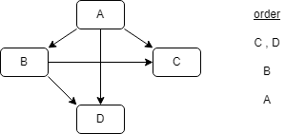
Concepts - Functions
Learned from make – run recipe on source to get target
When? If a target is stale with respect to any of its dependencies, the build manager runs a recipe to refresh it.
The build manager runs recipes in an order that respects dependencies, and it only runs each recipe once (if at all).
Constraint - in order for this to be possible, targets and dependencies must form a directed acyclic graph, i.e., there cannot be a cycle of links leading from a node back to itself.

Slide 21
Concepts – Initial Design
Build rules -> represent our recipes as JSON.
{
"A": {"depends": ["B"], "rule": "build A"},
"B": {"depends": [], "rule": "build B"}
}

Slide 22
Initial Design – Some coding
Start simple
Refine as you go
For now, “refreshing” means “prints the update rule”; we will come back and make this more sophisticated later.
Add complexity only when needed
class BuildBase:
def build(self, config_file):
config = self._configure(config_file)
ordered = self._topo_sort(config)
for node in ordered:
self._refresh(config, node)
def _refresh(self, config, node):
assert node in config, f"Unknown node {node}"
print(config[node]["rule"])

Slide 23
Initial Design
To load a configuration file, we read in the JSON, build a set of known targets, and then verify each rule using a helper method called _check
def _configure(self, config_file):
with open(config_file, "r") as reader:
config = json.load(reader)
known = set(config.keys())
return {
n: self._check(n, d, known)
for n, d in config.items()
}

Slide 24
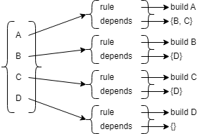
Initial Design – More code
To check a rule, we make sure the dictionary that represents it has the required keys and that we have a rule for every dependency it mentions. We also transform the rule’s structure a bit to simplify later processing:
def _check(self, name, details, known):
assert "rule" in details, f"Missing rule for {name}"
assert "depends" in details, f"Missing depends for {name}"
depends = set(details["depends"])
assert depends.issubset(known), \
f"Unknown depends for {name}"
return {"rule": details["rule"], "depends": depends}

Slide 25
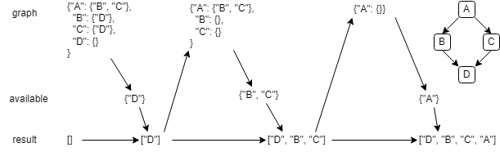
Central Algorithm
We find all the nodes in the dependency graph that don’t have any outstanding dependencies.
We append those to the result and then remove them from the dependencies of all the other nodes in the graph.
If anything is still in the graph, we go back to the first step.
If at any point the graph isn’t empty, but nothing is available, we have found a circular dependency, so we report the problem and fail.

Slide 26
Central Algorithm Implementation
def _topo_sort(self, config):
graph = {n: config[n]["depends"] for n in config}
result = []
while graph:
available = {n for n in graph if not graph[n]}
assert available, f"Circular graph {graph.keys()}"
result.extend(available)
graph = {
n: graph[n] - available
for n in graph
if n not in available
}
return result
What is the output?
{
"A": {"depends": ["B"], "rule": "build A"},
"B": {"depends": [], "rule": "build B"}
}

Slide 27
Design Refinement
Our implementation works, but we can do better:
The configuration might not come directly from a JSON file - for example, it might be embedded in a larger file or generated by another program - so we should modify the constructor to take a configuration as input. - Volatility
Printing actions to the screen isn’t very useful, so we should collect them and return an ordered list of the commands for the build manager.
assert isn’t a friendly way to handle user errors; we should raise ValueError (or a custom exception of our own) to indicate a problem.
Our topological sort isn’t stable, i.e., there’s no way to predict the order in which two “equal” nodes will be added to the ordering. We will explore the reason for this in the exercises, but for now, we should sort node names when appending to the result list so that our tests can know what to check for.
We might want to add other keys to rules, so we should put that check in a separate method that we can override.

Slide 28
Better Design
class BuildBetter:
def build(self, config):
config = self._configure(config)
ordered = self._topo_sort(config)
actions = []
for node in ordered:
self._refresh(config, node, actions)
return actions
def _refresh(self, config, node, actions):
assert node in config, f"Unknown node {node}"
actions.append(config[node]["rule"])
def _must(self, condition, message):
if not condition:
raise ValueError(message)
The top level of our better build manager looks like this:

Slide 29
Revised Configuration Code
def _configure(self, config):
known = set(config.keys())
return {n: self._check(n, d, known)
for n, d in config.items()}
def _check(self, name, details, known):
self._check_keys(name, details)
depends = set(details["depends"])
self._must(depends.issubset(known), f"Unknown depends for {name}")
result = details.copy()
result["depends"] = depends
return result
def _check_keys(self, name, details):
self._must("rule" in details, f"Missing rule for {name}")
self._must("depends" in details, f"Missing depends for {name}")

Slide 30
Updated Topological Sort
graph = {n: config[n]["depends"] for n in config}
result = []
while graph:
available = {n for n in graph if not graph[n]}
self._must(
available,
f"Circular graph {list(graph.keys())}",
)
result.extend(sorted(available))
graph = {
n: graph[n] - available
for n in graph
if n not in available
}
return result

Slide 31
Tests Are Always Good
from build_better import BuildBetter as Builder
def test_empty():
assert Builder().build({}) == []
def test_single():
action_A = "build A"
config = {"A": {"depends": [], "rule": action_A}}
assert Builder().build(config) == [action_A]

Slide 32
Is This a Good Design? Test by New Function
def test_diamond_dep():
action_A = "build A"
action_B = "build B"
action_C = "build C"
action_D = "build D"
config = {
"A": {"depends": ["B", "C"], "rule": action_A, "time": 0},
"B": {"depends": ["D"], "rule": action_B, "time": 0},
"C": {"depends": ["D"], "rule": action_C, "time": 1},
"D": {"depends": [], "rule": action_D, "time": 1},
}
assert Builder().build(config) == [action_B, action_A]
HOMEWORK!!!

Slide 33
Build with Timestamps
class BuildTime(BuildBetter):
def _check_keys(self, name, details):
super()._check_keys(name, details)
self._must("time" in details, f"No time for {name}")
def _refresh(self, config, node, actions):
assert node in config, f"Unknown node {node}"
if self._needs_update(config, node):
actions.append(config[node]["rule"])
def _needs_update(self, config, node):
return any(
config[node]["time"] < config[d]["time"]
for d in config[node]["depends"]
)

Slide 34
What We Actually Did
Our final design uses the Template Method pattern:
a method in a parent class defines the control flow, while child classes implement those operations.
We didn’t know in advance exactly how to divide our code into methods; instead, as we were creating a class that loaded and used timestamps, we reorganized the parent class to create the affordances we needed at the points of volatility.

Slide 35
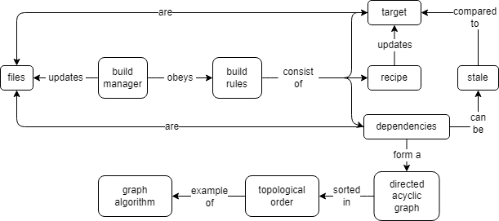
Summary

Slide 36
Homework
Which concepts were used?
Rewrite the configuration validator to use JSON Schema via the associated Python module.
Modify the build manager so that a configuration file can specify whether its rule should succeed or fail. (This isn’t particularly useful in real life, but it helps with testing.) Modify it so that if a rule fails, other buildable targets are still built (but anything that depends directly or indirectly on the target whose rule failed is not built). Write tests to check that this change works correctly.
Modify the build manager so that it can read multiple build files and execute their combined rules. What does your solution do if two or more files specify rules for the same target?
Write a program called build_init.py that calculates a hash for every file mentioned in the build configuration and stores the hash along with the file’s name in build_hash.json. Modify the build manager to compare the current hashes of files with those stored in build_hash.json to determine what is out of date, and to update build_hash.json each time it runs.
A dry run of a build shows the rules that would be executed but doesn’t actually execute them. Modify the build system in this chapter so that it can do dry runs.
A phony target is one that doesn’t correspond to a file. Developers often put phony targets in build files to give themselves an easy way to re-run tests, check code style, and so on. Modify the build system in this target so that users can mark targets as phony.
Modify the tool built in this chapter so that one build file can import definitions and dependencies from another. How does your system prevent circular dependencies?

